Slide 1


NODE.JS GLOBAL
NODE.JS INTRODUCTION
November, 2019

Slide 2
AGENDA
Agenda
Introduction & Prerequisites
What is Node.js
V8: The JavaScript Engine
The Node Core
Install & launch
Node.js & ECMAScript 2015/ESNext
Sources & Docs
Summary & Q&A

Slide 3

INTRODUCTION & PREREQUISITES
Module 1: Module 1. Basics. Node.js fundamental theory
Node.js Introduction. Modules. NPM
Events and Event Loop. Async Development Introduction
Filesystem and Streams
Module 2: In-memory CRUD REST service with validation
Handling HTTP and WebSocket Protocol
Middleware. Frameworks. Validation
Module 3: PostgreSQL and layered architecture
Layered Style Guides. Back-End Patterns
SQL Databases. ORM
Module 4: Second entity and many-to-many relationships
NoSQL Databases. ODM
Asynchronous Network API
All lectures will be conducted twice in two languages (RU/ENG)
All lectures will be recorded
RU start: 9 am / EN start: 2 pm + 1d

Slide 4
INTRODUCTION & PREREQUISITES
Module 5: Logging and error handling
Logging. Error Handling
Command Line. Debugging
Module 6: JWT authorization and CORS
Authorization. Security. CORS
Deploy and Tools
Module 7: Unit tests and config
Node.js Testing Experience
Swagger. Docs
Module 8: Serverless Architecture with AWS
Module 9: Dockerization (How to Use Containers)
All lectures will be conducted twice in two languages (RU/ENG)
All lectures will be recorded
RU start: 9 am / EN start: 2 pm + 1d

Slide 5
INTRODUCTION & PREREQUISITES
Prerequisites
JavaScript Core concepts
ES6+
Attitude and dedication
Software & tools we’ll use
Atom / VSCode / WebStorm / etc
Git
Command line
PostgreSQL RDMS
MongoDB (NoSQL RDMS)
A tool to send HTTP requests: Postman, Insomnia, curl, etc.

Slide 6
INTRODUCTION & PREREQUISITES
What am I going to get from this course?
Grasp how Node.js works under the hood
Understand the JavaScript and technical concepts behind Node.js
Structure a Node application in modules
Understand and use the Event Emitter
Understand Buffers, Streams, and Pipes
Build a Web Server in Node and understand how it really works
Use npm and manage node packages
Build a web application and API more easily using Express
Connect to a SQL/NoSQL database in Node

Slide 7



WHAT IS NODE.JS?

Slide 8
WHAT IS NODE.JS?
Node.js:
Server-side JavaScript •
Asynchronous event driven JavaScript runtime designed to build scalable network applications
Open source & cross-platform project
Built on Chrome's V8 JavaScript engine
Non-blocking IO (almost)
Single threaded (almost)
There is no DOM implementation provided by Node.js

Slide 9
WHAT IS NODE.JS?
History:
Created by Ryan Dahl, first 2009 for only Linux.
Sponsored by Joyent
June 2011, Microsoft partnered with Joyent to help create a native Windows version of Node.js.
January 2012, Ryan stepped aside, npm creator Isaac Schlueter manage the project
January 2014, Timothy J. Fontaine became new project lead.
December 2014, Fedor Indutny started IO.js
September 2015, Node.js v0.12 and io.js v3.3 were merged back together into Node v4.0

Slide 10
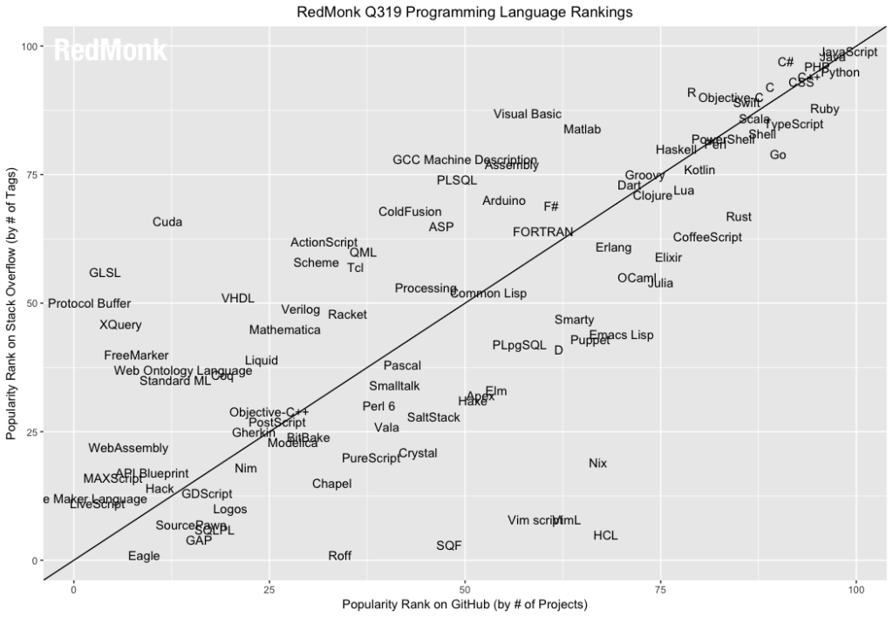
WHAT IS NODE.JS?
Source: https://redmonk.com/sogrady/2019/07/18/language-rankings-6-19/

Slide 11
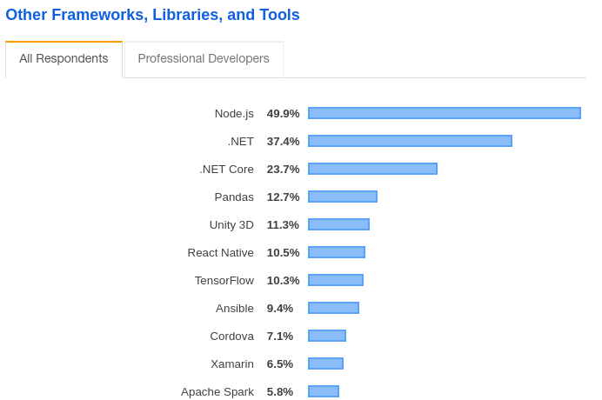
WHAT IS NODE.JS?
Source: https://insights.stackoverflow.com/survey/2019#technology-_-other-frameworks-libraries-and-tools

Slide 12
WHAT IS NODE.JS?
Node.js ecosystem:
Node.js heavily relies on modules
Libraries in Node.js are called packages and they can be installed differently:
Sources of modules could be used:
Built-in
Custom (your files)
Global package registry (npmjs)
Private package registry
Git repository
Package manager (npm) comes bundled with Node.js installation

Slide 13
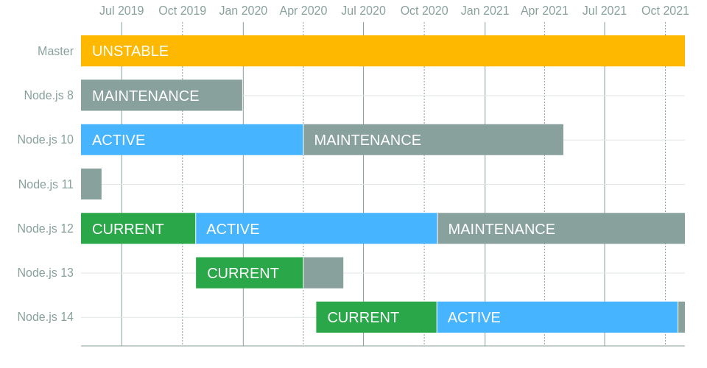
WHAT IS NODE.JS?
https://github.com/nodejs/Release

Slide 14
WHAT IS NODE.JS?
NPM - the package manager for JavaScript and the world’s largest software registry. Discover packages of reusable code — and assemble them in powerful new ways.

Slide 15
WHAT IS NODE.JS?
NPM registry contains more than 836,000 packages. In fact, it is currently the largest package registry in the world.
97% of the code in a modern web app comes from npm
ping.npmjs.com shows that the registry's services offer a 99.98-100.00 uptime (in the past 90 days)

Slide 16
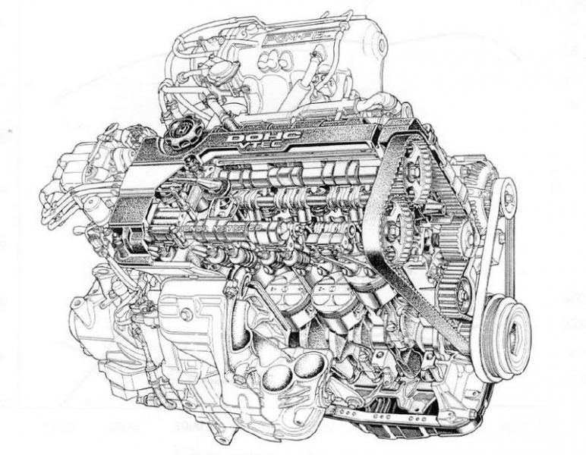
V8: THE JAVASCRIPT ENGINE
An ECMAScript engine is a program that executes source code written in a version of the ECMAScript language standard, for example, JavaScript.
JavaScript Engine – a program that converts JavaScript code into something the computer processor can understand. It should follow the ECMAScript standard on how the language should work and what features it should have
Take a look at list of JavaScript engines

Slide 17
V8: THE JAVASCRIPT ENGINE
V8 is Google’s open source high-performance JavaScript engine, written in C++ and used in Google Chrome, the open source browser from Google. It implements ECMAScript as specified in ECMA-262, and runs on Windows 7 or later, macOS 10.5+, and Linux systems that use IA-32, ARM, or MIPS processors.
V8 can run standalone, or can be embedded into any C++ application

Slide 18
V8: THE JAVASCRIPT ENGINE
What do we know about V8?
V8 is an open source JavaScript engine developed by Google. Its written in C++ and is used in Google Chrome Browser
Implements latest ECMAScript standard
Node.js runs on V8
Ryan Dahl: ”Node.js is a set of bindings to the V8 JavaScript VM”

Slide 19
LIBUV: CROSS-PLATFORM ASYNCHRONUS I/O
libuv is a multi-platform support library with a focus on asynchronous I/O. It was primarily developed for use by Node.js, but it's also used by Luvit, Julia, pyuv, and others.

Slide 20
LIBUV: CROSS-PLATFORM ASYNCHRONUS I/O
Full-featured event loop backed by epoll, kqueue, IOCP, event ports.
Asynchronous TCP and UDP sockets
Asynchronous DNS resolution
Asynchronous file and file system operations
File system events
ANSI escape code controlled TTY
IPC with socket sharing, using Unix domain sockets or named pipes (Windows)
Child processes
Thread pool
Signal handling
High resolution clock
Threading and synchronization primitives

Slide 21
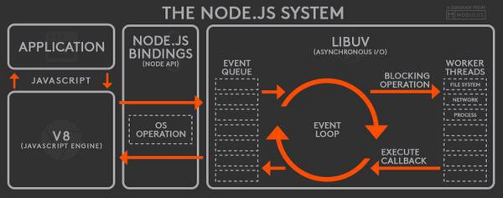
NODEJS: LIBUV + V8

Slide 22
THE NODE CORE
What Does JavaScript Need to Manage a Server?
Ways to organize code into reusable pieces
Ways to deal with files
Ways to deal with databases
The ability to communicate over the internet
The ability to accept requests and send responses
A way to deal with work that takes a long time

Slide 23
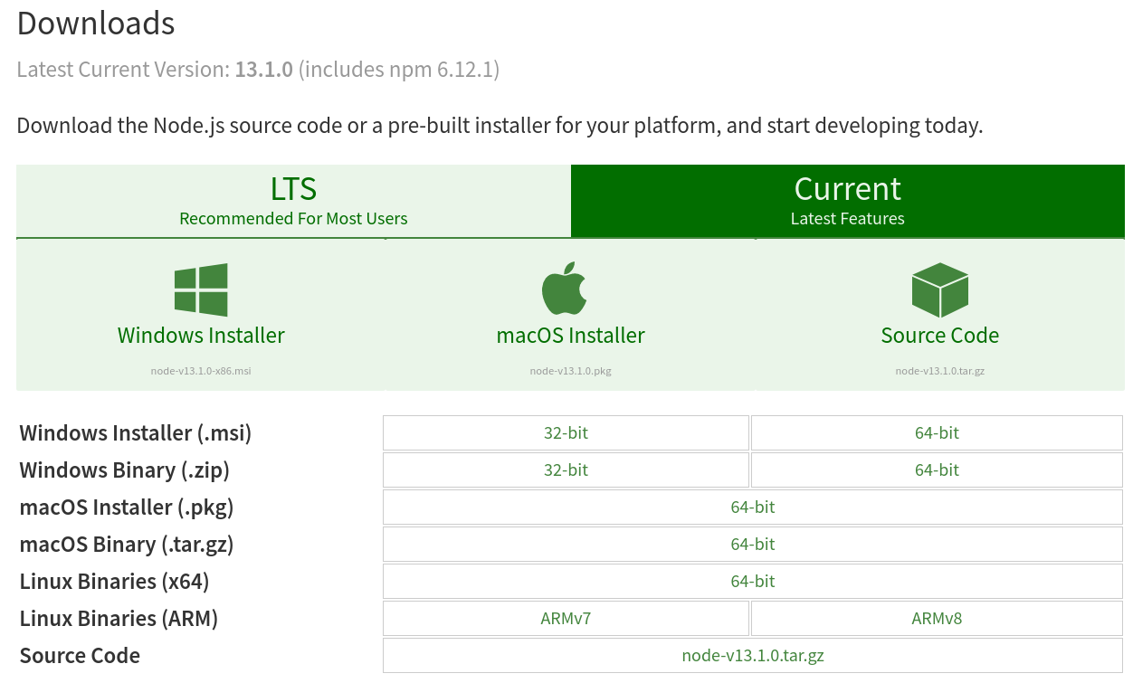
INSTALL AND LAUNCH
In order to get Node.js you should:
Go to the official website and download the executable installer: https://nodejs.org/en/download/
Or Install it from CLI via “homebrew”, “nvm”, etc.
And check the installed version with commands: node -v and npm -v

Slide 24
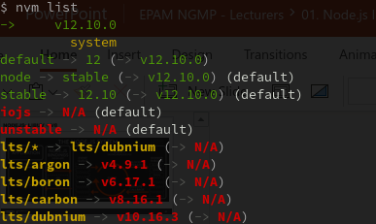
INSTALL AND LAUNCH

Slide 25
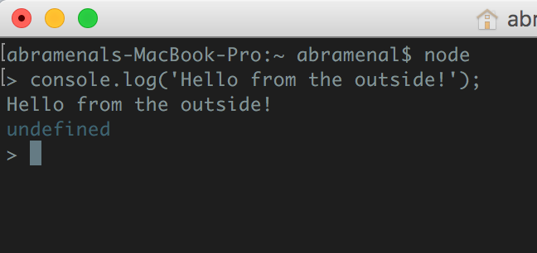
INSTALL AND LAUNCH
To launch the Node.js CLI
Open the terminal (PowerShell) window
Type node to get into the REPL
Check any command

Slide 26
NODE.JS AND ECMAScript 2015 / ESNEXT
To check any feature availability per version - simply go to http://node.green/
To check any ESNext feature availability - http://kangax.github.io/compat-table/esnext/

Slide 27
SOURCES AND DOCS
Official Node.js repository: https://github.com/nodejs/node
Official Node.js Documentation set: NodeJS.org

Slide 28






SUMMARY AND Q&A
Companies using Node.js

Slide 29



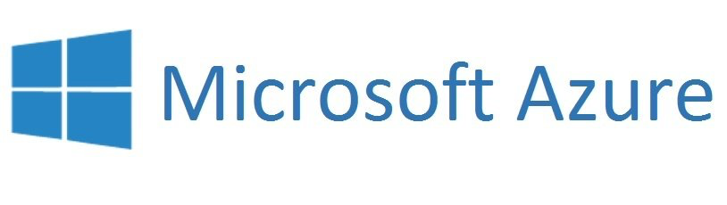
SUMMARY AND Q&A
Node.js hosting companies

Slide 30
SUMMARY Q&A
Useful links:
Node.js mentoring program on KB
Node.js official website (visit download and documentation pages)
List of JavaScript engines
ECMAScript specification
V8 source code and V8 Wiki
Node.js source code
Node green (for monitoring ECMAScript features support) and Kangax compat-able (for ES Next)
Libuv website and GitHub

Slide 31
NODE.JS INTRODUCTION BY YEVHEN NEZHUTA PAVEL AURAMENKA
NODE.JS GLOBAL

